Slide 1
Daycare Management System
Welcome!
This is an overview of the database and back-end structure behind my project
For this project we've implemented a Daycare Management System, designed for efficient management of staff, parents, child attendance, learning activities, billing and more ...

Slide 2
SQL Data Definition Language
1
Use SQL statement
Create table
2
3
Insert into table
Alter table
4
5
Delete table

Slide 3
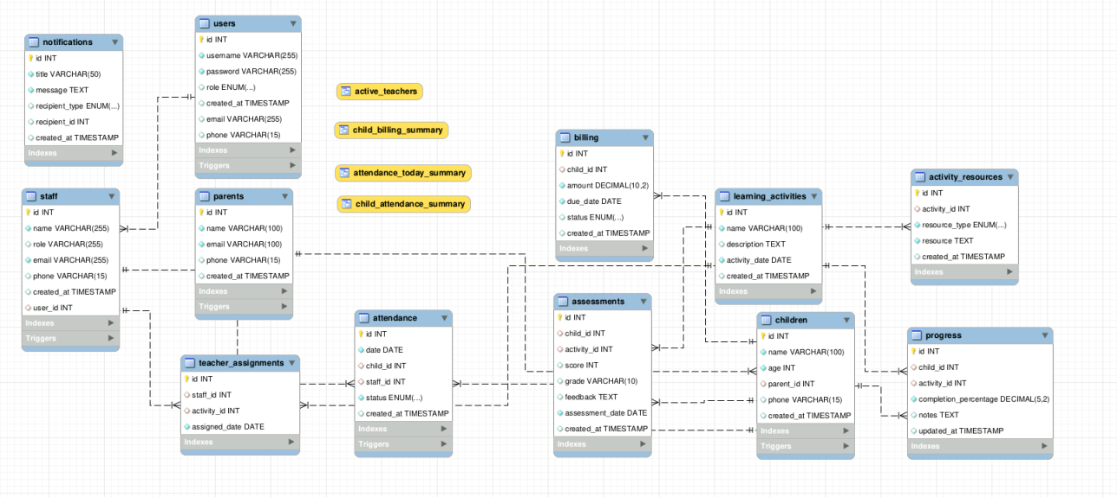
Snippet of the ER Diagram
1

Slide 4
Isolation level
3
This database uses MySQL and is using the default isolation level “REPEATABLE READ” to avoid dirty read and prevent non-repeatable reads while maintaining performance
Isolation levels are applied at the transaction level
Example of the store procedure
( create_billing_for_attendance)
To ensure that billing is created only once per attendance entry, even if multiple staff are using the system simultaneously.

Slide 5
Primary keys
To ensure unique record
Every record in each table is uniquely identified
Integrity Enforcement
Foreign key
To maintain relational integrity for proper connection between tables
Logical relationships with foreign keys

Slide 6
Normalization
For Normalization the
3rd Normal Form is applied
Remove transitive dependencies
No repeating data
All attributes depends on the primary key

Slide 7
Database made of 12 tables each with the CRUD functionality
Users
Parent
Children
Attendance
Contains the users separated by role.
Admin and Staff
Contains parents information
Contains child information
Keep track of children’s attendance

Slide 8
View
2
These allow staff to retrieve meaningful data without complex queries.
create_billing_for_attendance
- to get list of active staff.
create_billing_for_attendance
- for staff to view number of child present.
create_billing_for_attendance
- for staff to view attendance summary
create_billing_for_attendance
- Shows the total amount billed and payment status.

Slide 9
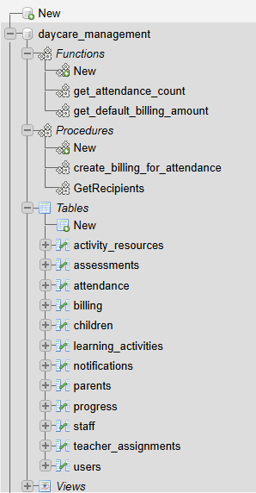
Procedure
Function
get_attendance_count to dynamically fetch daily attendance count for reporting
create_billing_for_attendance
Procedure help automate logic like automatically generate billing when we take attendance for child
Automatically insert data to the staff table when the user role is staff
and more
Triggers

Slide 10
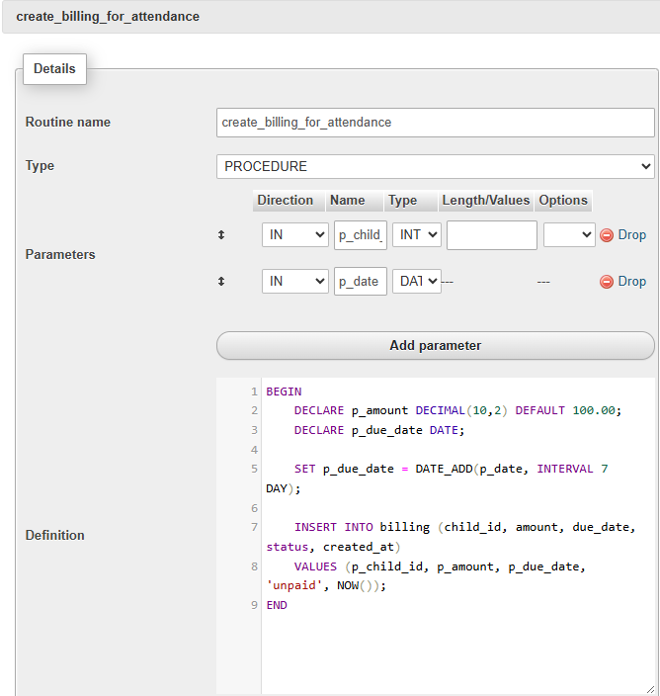
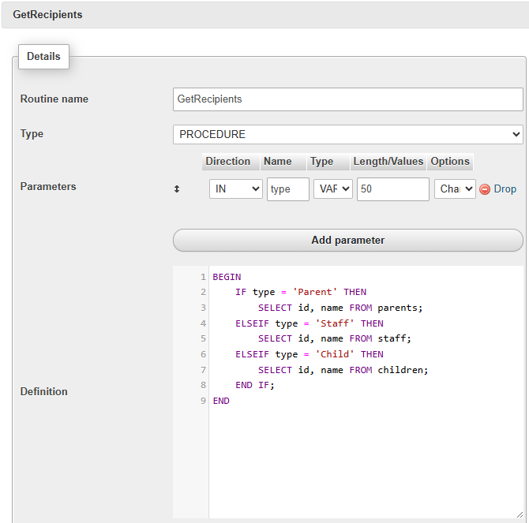
Example Procedure Screenshot

Slide 11
Thank you
Next - Live Application Demo

